Slide 1
Economic Immigration Lab
Cycle One
Summary Report

Slide 2
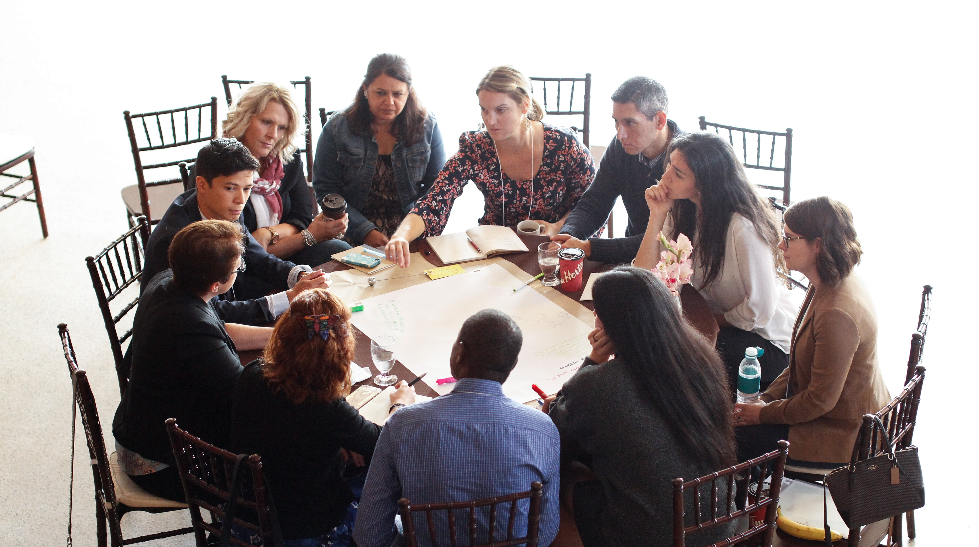
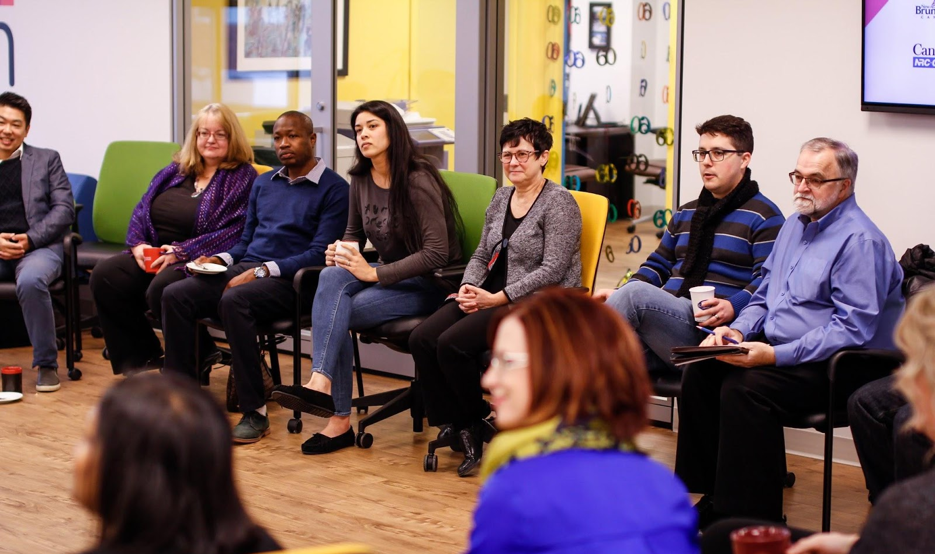
Academia
Settlement Sector
Newcomers
34 Participants
Private Sector
Government
8 Prototypes
9 Workshop days
The Lab participants were on a mission to discover answers to these questions:
How might we become leaders at attracting, welcoming and retaining newcomers to contribute to the economy of New Brunswick?
How might we help newcomers to find meaningful employment and feel part of the New Brunswick community?
How might we help employers find talent to grow their businesses?

Slide 3
Key Insights
Employer Experience
Employers unaware of the benefits of hiring immigrants
The hiring needs of employers are not well understood or communicated
The resources available to employers are confusing, and poorly communicated. Employers need a simpler way to understand the resources that are available, and how to take advantage of them
Newcomer Experience
Mismatch between how NB is presented to potential immigrants, and the reality
Meaningful integration of newcomer families into communities is equally as important as finding a good job - and these are the two biggest indicators for retention
Newcomer entrepreneurs are unable to meaningfully participate in established business networks due to language and cultural barriers
Newcomers do not see themselves reflected in the government, and those with power
International Students unaware of resources available to them to support their integration
The benefits and the absolute necessity of immigration to NB is not common public knowledge

Slide 4
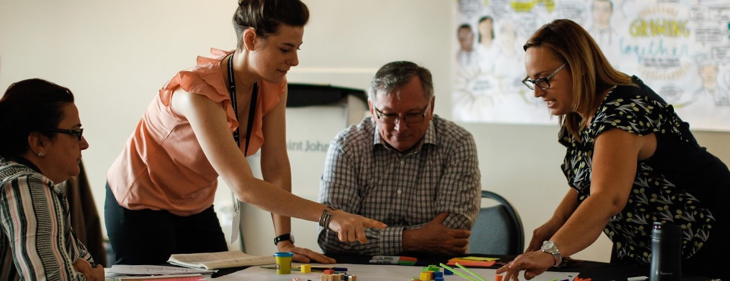
“We were looking for workers, but instead we got people.”
Prototypes addressing unmet needs of employers
Employer to Government Connection
Connecting employers with relevant government services
Purpose: To raise awareness about current services available to employers and prototype a screening tool that helps employers assess and identify their hiring needs, and match them with appropriate resources and support.
Status: Ongoing
Team Members: Andree Caissie Savoie - Imperial Manufacturing Group , Jake Arbuckle - GNB: Population Growth Division, Marie Thibeault - ACOA, Patrick Richard - ONB, Stephen Alexander- Enterprise Saint John
Destination NB
A “one stop shop” for employers looking to hire newcomers. This prototype validated a project that the province has already begun working on.
Purpose: To help employers navigate the resources available to recruit and retain newcomers.
Status: Ongoing
Team Members: Ashley Noel - PETL, Kari Cheyne - MAGMA, Natalie Condron - IRCC, Abby David - NBMC

Slide 5
Prototypes addressing unmet needs of newcomers
Newcomer to Influencer
Match immigrants with jobs in the government through 1 year internships. Develop a clear on-boarding workbook to help new employees understand their role in the organization.
Purpose: To improve diversity in government employees and show a clear path between entry-level positions and upper management
Status: Ongoing and received funding
Team Members: Renu Dhayagude - GNB: Executive Council Office, Mikael Hellstrom - UNBSJ, Robert Burroughs - Formerly with NB Student Alliance , Laurie Parris - Multicultural Association of Charlotte County
‘If we’re not changing our relationships, we’ll stay stuck in the same patterns’
Community Engagement
A toolkit for community events to bridge newcomer communities and settled communities
Purpose: To enhance the current model of interaction between locals and newcomers in order to allow them to settle and integrate better in our workforce and in our community.
Status: Ongoing
Team Members: Sebastián Salazar- City of Fredericton, Diluckshnie Jayawardena - Sitel, Leticia Leon de Gante - LIP Fredericton, Lisa Bamford de Gante - Fredericton Multicultural Association, Nicolas Bertrand - Steps2Canada, Tiziana Zevallos - UNB
Dreamweavers
Support for educators including: package of resources, train the trainer programming, grant program, and community of practice
Purpose: Helping educators around New Brunswick address the cultural gap between locals and newcomers
Status: Ongoing
Team Members: Lauren Sears - Common Good Solutions, Kathy Whynot - Department of Education and Early Childhood Development , Heather Keats - PETL

Slide 6
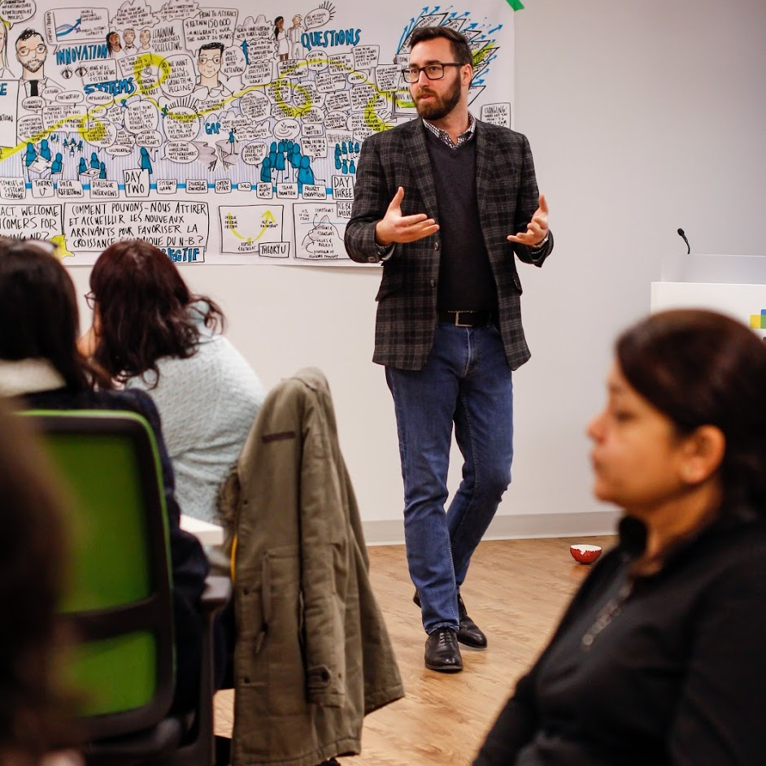
Prototypes addressing unmet needs of newcomers
Business Immigration
Building a business council for new immigrants and hosting a conference for business immigrants to share knowledge
Purpose: Support immigrant business owners to meaningfully participate and lobby for their needs. Make NB known for having a track record of supporting immigrant business people.
Status: Seeking funding
Team Members: Roxanne Reeves - UNB, Adam Luo - ONB, Kinh Huynh - MFCIC Business Services Inc, Janet Moser - Fredericton Chamber of Commerce
Match NB
A matching service for recently settled immigrants to find employers that need their skillset. Like Tinder for employee/ employer matches
Purpose: Helping those newcomers already here find the jobs appropriate to their skillset and prevent the ongoing skills loss to other provinces
Status: Ongoing
Team Members: Erika Cantu - Steps2Canada, Steven Fecteau - Sunnymel Foods, Rahma Kouraich - Atlantic Human Services
Les Connecteurs
Improve awareness and access to the SEED program, to ensure the long-term success of newcomer students.
Purpose: Ensure students are well informed and prepared for life in New Brunswick after graduation. Provide international students with similar supports as NB residents.
Status: Ongoing
Team Members: Leyla Sall - UdeM, Lisa Griffin Ndour - UdeM, Jean-Claude Bagnah - ACOA, Charles Fournier - CAFI

Slide 7
Participant Feedback
Participants were asked to rate the value of the lab experience on scale of 0 to 10
20% of participants rated the lab 10/10
“We stepped away from our own work, and are feeling optimistic about the work that we’re carrying forward.”
“The relationships that I’ve built are amazing. Tremendous new friends. Such a positive experience. The whole process was well designed.”
“I have worked in government for 10 years and needed new wind in my sails, and this lab gave me that. We don’t have a result right now that I’m taking forward, but I have the experience and new tools.”
20% of participants rated the lab 9.5/10
“I came to this lab with two hats, professional and newcomer, but today I am here for my newcomer friends. I want to show my newcomer friends the amazing work that is being done here.”
“I didn’t rate it 100% because i could not put the time in that I had hoped between workshops.”
“It was absolutely worth it for me personally.”
20% of participants rated the lab 8/10
“On the personal level it was a profound experience, and very gratifying. Held back from giving a 10/10 because of unclarity of next steps.”
“It allowed my other work to accelerate. I feel satisfied that I have a map and a destination, but still discovering the exact terrain and vehicle.”
“Some things I already do at work, but it was validating to do it here.”
20% of participants rated the lab 7.5/10
"I have taken tools and skills from this, take home and to my work.”
“The knowledge is of value, we would not have gotten elsewhere.”
“I will carry forward networks, knowledge, skills.”
20% of participants rated the lab 5/10
“I don’t know if it’s worth my time, [my rating will be] 100% if the work shows some results.”
“I made a lot of connections, networks.”
“The end result will be known in time, reserving my judgement for now.”

Slide 8
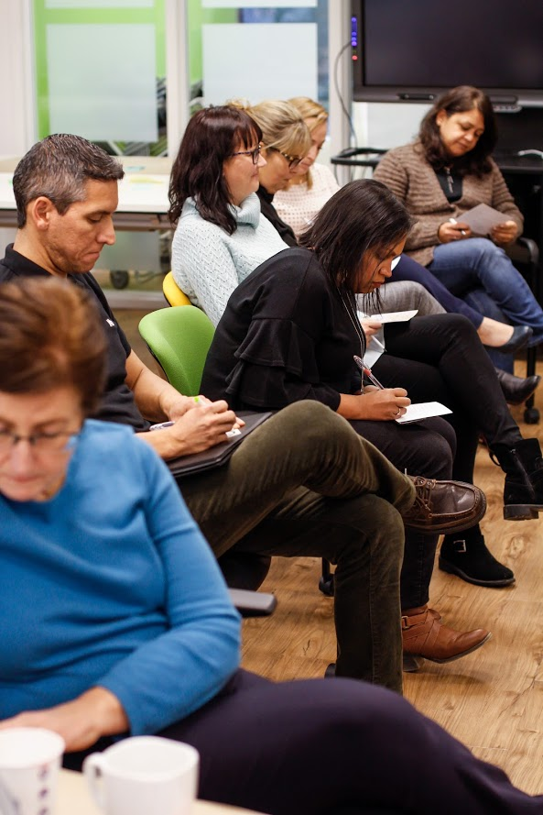
Next Steps
Cycle two is kicking off April 16th with teams focusing in on employer and newcomer needs
The NouLAB team is providing ongoing support for the teams continuing to work on their prototypes
Sharing the learning nationwide with other similar initiatives

