Slide 1
Boosting immigration: Critical to our future quality of life
September 2017

Slide 2
The Challenge
Until a decade ago, New Brunswick’s labour market was growing at a rate of several thousand new entrants per year.
Almost all of this labour market growth came from New Brunswickers young and old joining the labour market.
Now, the labour market is in structural decline and we need a substantial boost in immigration to ensure that our important industries have the workers they need.

Slide 3
The Challenge
This is the biggest public policy challenge of our time.
Similar scale to equal opportunity in the 1960s.
How to attract and retain 150,000 immigrants over the next 20 years?
We are trying to do something rarely if ever done before – a massive boost in immigration in a short period of time.

Slide 4
What’s at stake?
The difference between a healthy, vibrant economy that is generating enough tax revenue to sustainably fund good quality public services and public infrastructure…
and
An economy where firms increasingly can’t find workers even to provide local services and it is increasingly challenging to generate enough tax revenue.
Managing the challenges of growth versus managing the challenges of decline.

Slide 5
What’s at stake?
Which battles would you prefer to fight over the next decade?
How to integrate immigrant kids into our schools? | OR | Which taxes to raise to fund health care?
How to convince firms to hire immigrants? | OR | How to generate sustainable tax revenue as firms downsize and close?
How to attract/retain immigrants in rural areas? | OR | Which schools, hospitals and roads should close?

Slide 6
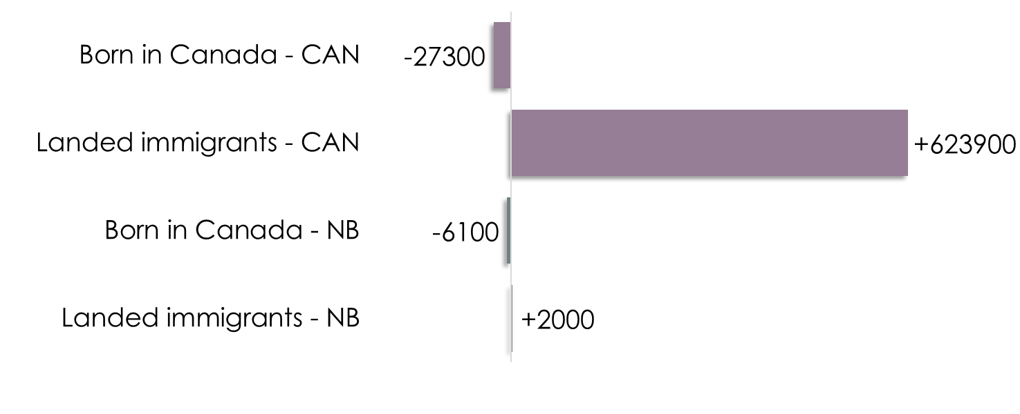
Growth in the labour market (2012-2016)
Boosting immigration:
Critical to bringing New Brunswick back to sustained economic growth
April 2017
Source: Statistics Canada CANSIM Table 282-0102.

Slide 7
Immigration per 10,000 population (CMAs)
Annual average by five year increments
Source: Statistics Canada CANSIM Table 051-0057.

Slide 8
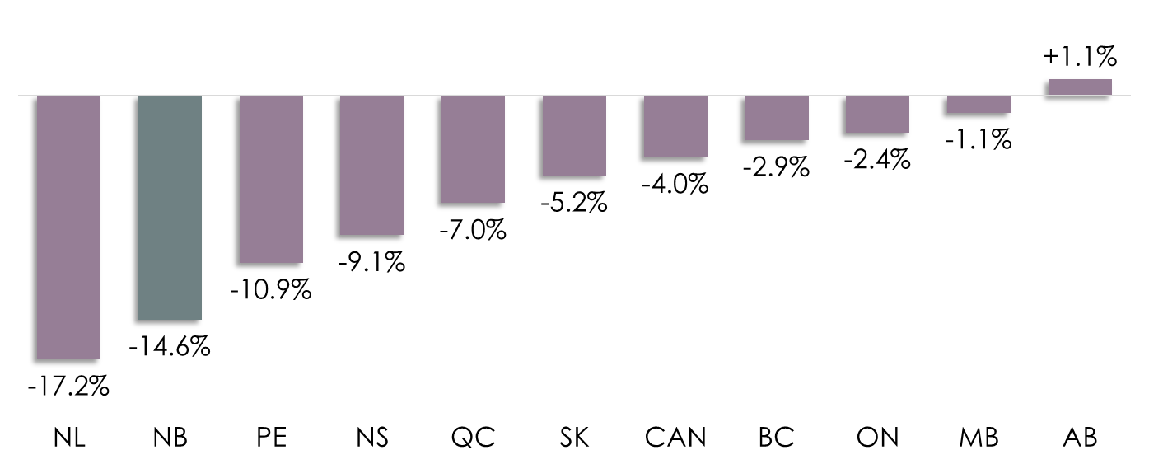
Percentage change: Number of young people earning $35,000 or less in annual income (2008-2015)
Source: Statistics Canada.

Slide 9
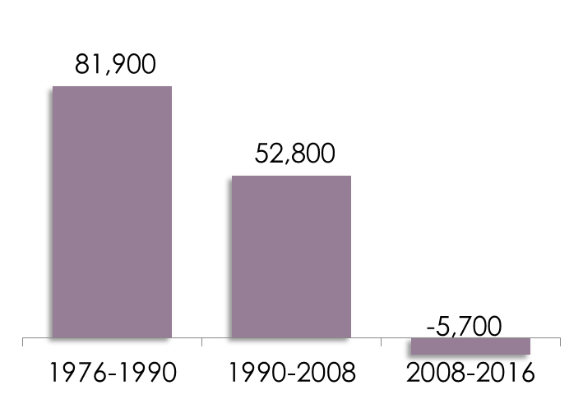
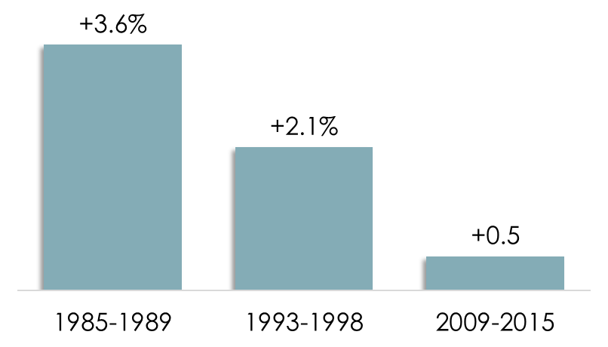
Labour force growth drives economic growth
Avg. annual post-recession real GDP growth rates
New Brunswick labour market growth
Post-Recession Period
Source: Statistics Canada CANSIM Tables 379-0030 and 0003.
Notes:
WHERE WE’VE BEEN

Slide 10
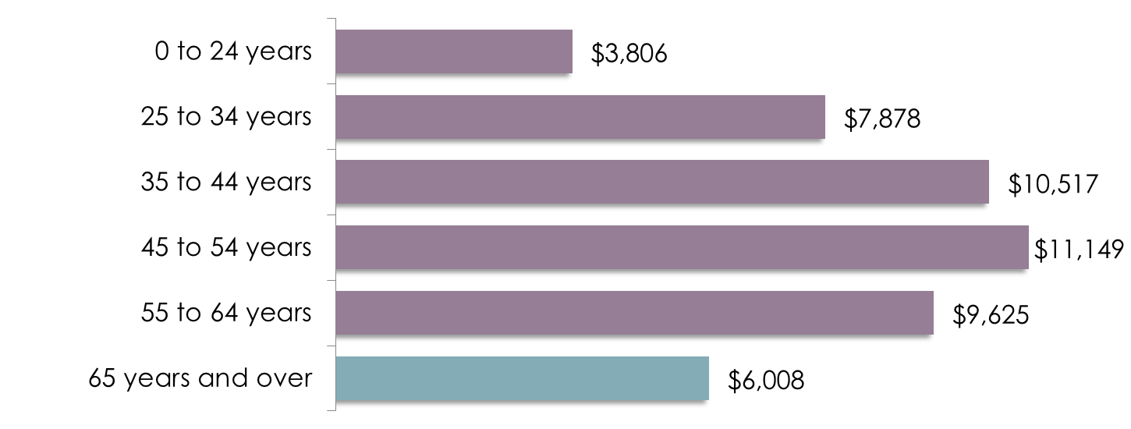
Avg. income taxes paid by age cohort
New Brunswick
Source: Statistics Canada CANSIM Table 111-0044.

Slide 11
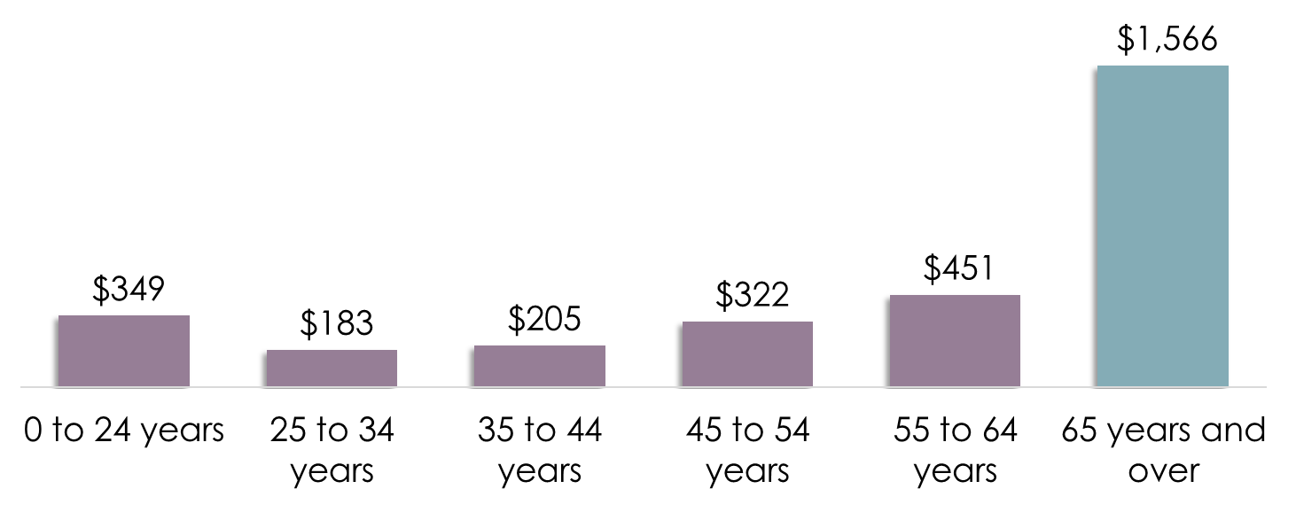
New Brunswick health expenditures by age cohort ($ Millions)
Source: CIHI 2012 data.

Slide 12
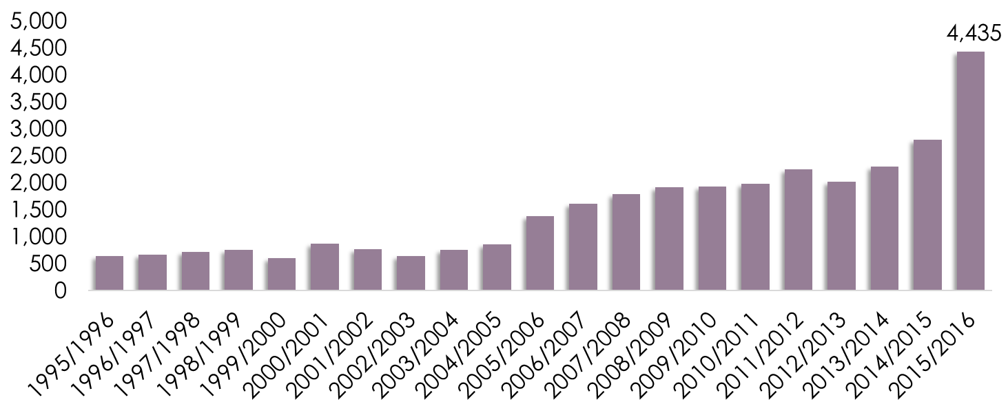
Recent trends: Immigration to New Brunswick
Source: Statistics Canada CANSIM Table 051-0004.
Notes:
WHERE WE’VE BEEN

Slide 13
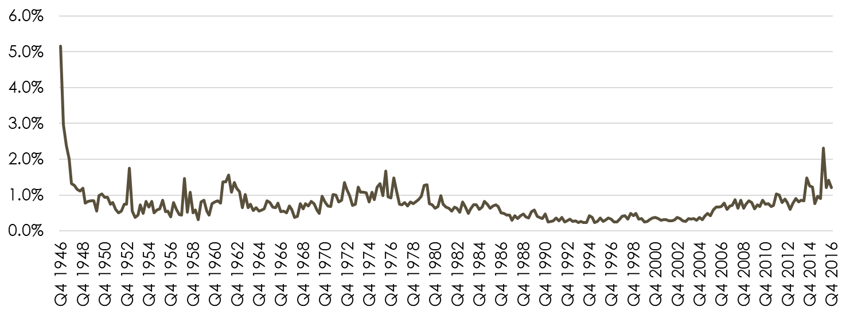
Immigration to New Brunswick: As a share of national totals (1946-present)
Source: Statistics Canada CANSIM Table 051-0037.
Notes:
WHERE WE’VE BEEN

Slide 14
Levelling the playing field
Historically most immigrants flowed into Canada’s largest urban centres.
Smaller urban centres relied on natural population growth and some intra- and inter-provincial migration.
Now those sources of population growth are drying up.
We need far more thinking about the role of immigration into smaller urban centres and rural areas.
And far more focus/investment otherwise the national economy will suffer.

Slide 15
Levelling the playing field
Businesses in Canada’s largest cities hire many immigrants – but they hire them off the street.
In New Brunswick, we are asking them to recruit internationally.
In Vancouver, 47% of all administrative services workers are immigrants (Toronto over 50%). It is less than 5% in New Brunswick.
The share of immigrant workers in manufacturing and utilities occupations: Toronto CMA 76%, New Brunswick 3%.
We need to make immigrant worker recruitment as easy as possible otherwise New Brunswick firms will be at a competitive disadvantage.

Slide 16
Levelling the playing field
Canada’s largest cities have mature immigrant ecosystems – ethnocultural groups, churches/mosques, media, services.
New Brunswick is playing catch up even as the numbers are swelling.
There will be substantial competition for new immigrants across Canada.
We should set national immigration targets based on individual provincial assessment of future needs.
And don’t obsess with ‘retention’.

Slide 17
Rural immigration
Most immigrants settle in urban areas (globally).
Target immigrants who prefer the small town/rural lifestyle.
Align immigration with rural needs – farmers, tourism operators, natural resources occupations, home care, local services.
Use ‘smallness’ as an advantage (St. Stephen example).

Slide 18
Questions?

