Slide 1
September 13th, 2017

Slide 2
Agenda
What is Catalyst?
Creative Problem Solving Style Profile

Slide 3
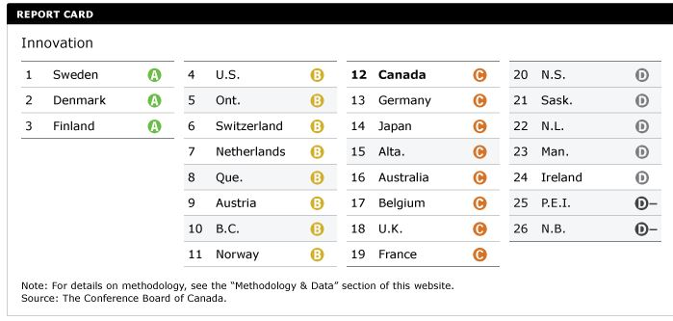
Why Catalyst?

Slide 4
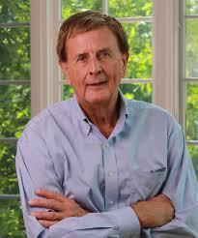
Dr Min Basadur
Professor Emeritus of Innovation, McMaster University
Degrees in Engineering Physics & Organizational Psychology
Started career in R&D for Proctor & Gamble
Holder of 4 patents
Creator of award winning Simplexity Thinking System
"I have been involved with several consultants but religiously adhere to the teachings of only two: Min Basadur and Tom Peters. Min’s value to me and ultimately to The Coca Cola Company has been invaluable."
- Steven C. Jones, Chief Marketing Officer, Senior VP, The Coca Cola Company.

Slide 5
Basadur Recent Clients
5

Slide 6
Catalyst Recent Clients

Slide 7
What are clients using Catalyst for?
Creating new products & services
Strategic Planning
Improving Existing products
Recruitment & Hiring
Ideation
Improving Employee/Company Productivity
Increasing Revenue
Decreasing Costs
Building Team Cohesion & Alignment

Slide 8
Let’s make a framework for understanding
Content (The What)
Innovative
Results =
+
Process (The How)
+
Process Skills
(to make the process work)((
+
Process Tools
(to be used skillfully)((
+
Appreciating Other’s Process Styles

Slide 9
A Fundamental Concept
Creative performance is a balance of
Knowledge, Imagination, Evaluation, and Action
But we have different styles of using this combination …

Slide 10
The Creative Problem Solving Profile : How we are different
Two ways of gaining knowledge:
Through direct experience
Using abstract thought
Notes:
The Profile measures two things:
One is how a person prefers to gain knowledge, to learn. At one end of the axis is learning through direct experience. This can best be described as learning by jumping right in and getting your hands dirty. If there is a set of directions, they aren’t used.
At the opposite end is learning through abstract thinking. This can be described as mentally figuring out what to do before actually trying it, including watching someone else, or asking questions to help get a better understanding.
We all fall somewhere in between these two extremes. We all learn using both, but each of us tends to prefer one more than the other and hence we all fall somewhere in between.

Slide 11
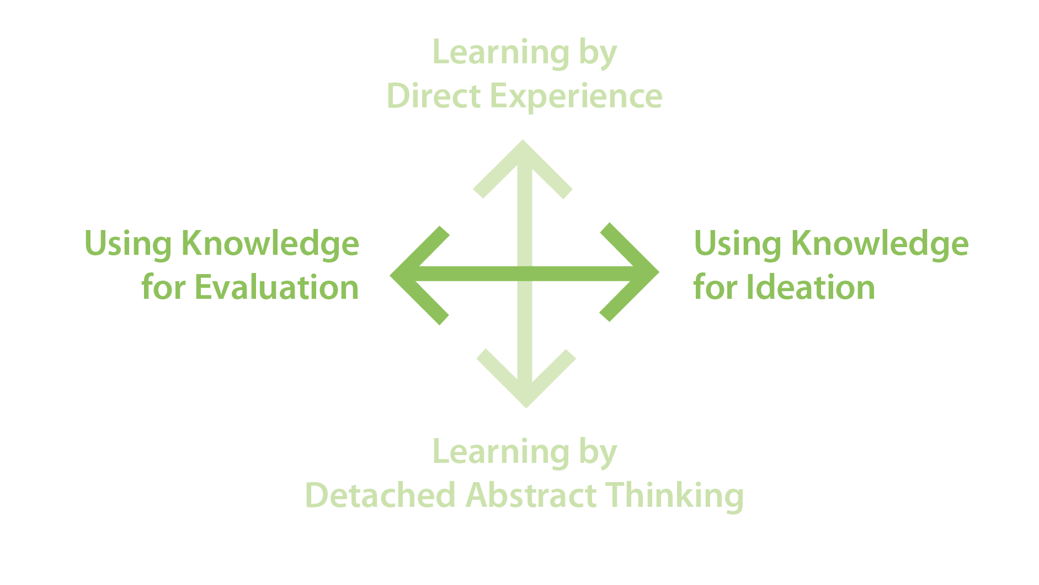
The Creative Problem Solving Profile : How we are different
Two ways of using knowledge:
To ideate (create options)
To evaluate (judge options)
Notes:
The second thing the Profile measures is how a person prefers to use their knowledge. At one end of the axis is using knowledge to generate options. This is your imagination at work.
At the opposite end is using knowledge for evaluation. This is your judgment.
Again, we all fall somewhere in between these two extremes. We all have imagination and judgment abilities, but each of us tends to prefer one more than the other and on the graph everyone falls somewhere in between the two extremes.

Slide 12
Two Different Ways of Gaining Knowledge and Using Knowledge

Slide 13
Split the page in half vertically then make a T-bar

Slide 14
Make a list on each side: “When I am problem solving, here are some things I…..
Do Well or Like to Do
Don’t Do So Well or Don’t Like to Do

Slide 15
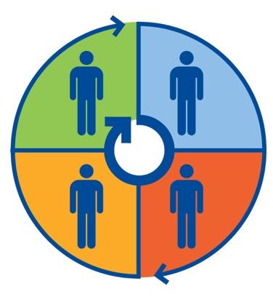
The Creative Process Has Four Stages
Implementing
Generating
“Getting things done”
“Getting things started – finding new problems & opportunities”
Optimizing
Conceptualizing
“Turning abstract ideas into practical solutions and plans”
“Defining problems & putting ideas together”

Slide 16
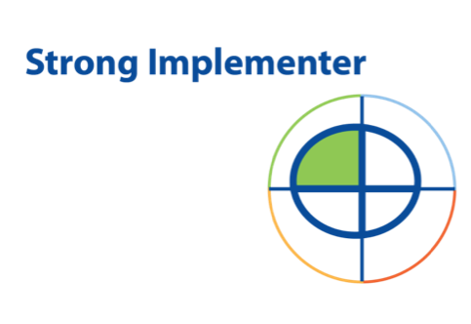
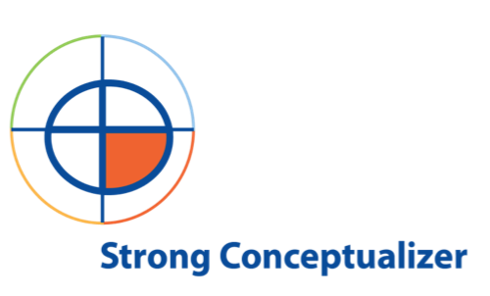
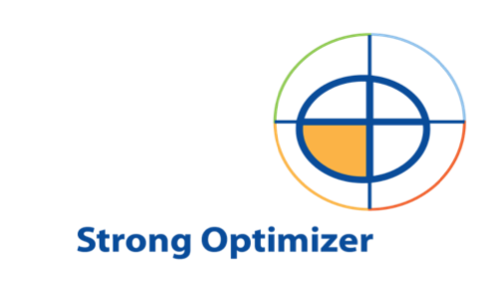
These four combinations create four different process styles

Slide 17
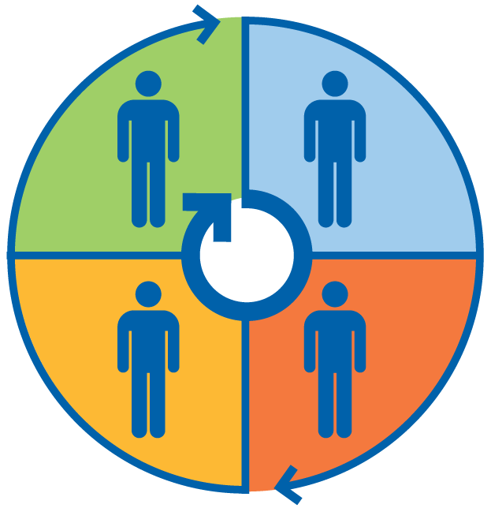
Which might be your most preferred style ?
Experiencing
Generator
Implementer
“Getting things started”
new problems, challenges
different perspectives
create options (diverge) rather than evaluate
enjoy ambiguity
keep all options open
“Getting it done”
action, results
understanding not necessary
adapt to changing circumstances
enthusiastic but impatient
bring others on board, but …
dislike apathy
Evaluation
Ideation
Optimizer
Conceptualizer
“Turn abstract ideas into practical solutions and plans”
analytical thinking
practical solutions to well defined problems
find the critical few factors
Evaluate options rather than diverge
see little value in “dreaming”
dislike ambiguity
“Putting ideas together”
abstract thinking
create new insights
problem definition; big picture
clear understanding necessary
high sensitivity to and appreciation of ideas
not concerned with moving to action
Thinking
17

Slide 18
Quadrant Tensions

Slide 19
Implementers View of Conceptualizers
Wonder why they get paid
Never see them do anything
Always see them thinking
Notes:
Quadrant 4s, Implementers, think that Conceptualizers, Quadrant 2s, should not get paid because they never actually see them do anything; they are always seen thinking and talking, but “never” implementing anything.

Slide 20
Conceptualizers View of Implementers
Dangerous because they’ll do anything
Don’t appear to think first
Bang their heads against the wall
Notes:
Conversely, Conceptualizers think that Implementers are dangerous because they’ll do anything without ever appearing to actually think about the real problem. Implementers will try one thing and if it doesn’t work they try something else.

Slide 21
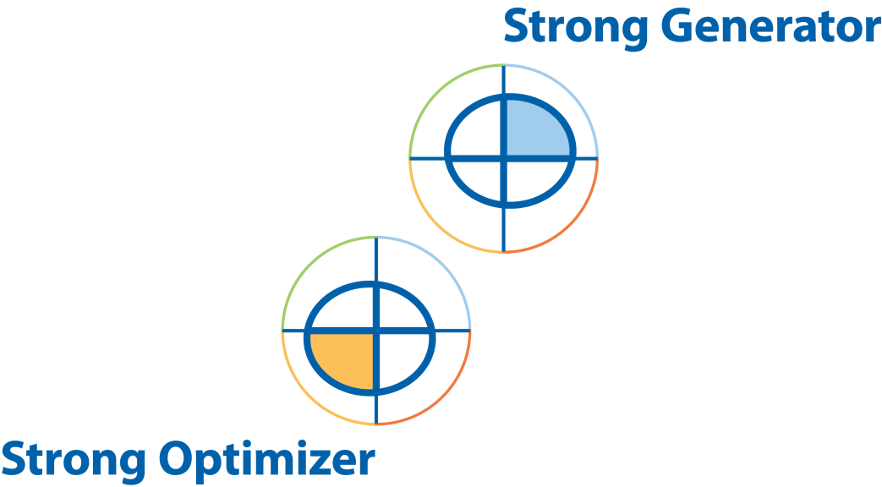
Optimizers View of Generators
Unable to focus on the “real” problem
They start working on five new problems before one is solved
Are hard to “pin down”
Notes:
Optimizers view Generators as being “airy fairy” people who are unable to make up their minds and focus on the “real” work. To an Optimizer, Generators come up with five new problems before the first problem they came up with has even been solved.

Slide 22
Generators View of Optimizers
Too narrow minded
Cannot see the big picture
Think they know the right answer but might be for the wrong problem
Notes:
Quadrant 1s, Generators, view Quadrant 3s, Optimizers, as being too narrow-minded – the “green eyeshade” people – who cannot, do not see the big picture. Optimizers are very confident that they know the right answer to the problem, but Generators see them as working on the wrong problem.

Slide 23
Quadrant Job Types

Slide 24
Generators
Artistic professions
Marketing
Training and development
Industrial engineering
Teachers
Entrepreneurship students
Notes:
Generators: Occupations that require people to initiate change, recognize opportunities and new possibilities, start projects, and to work with people in unstructured situations might thus be expected to contain a relatively high proportion of Generator (Quadrant I dominant) individuals. Typical occupations here would be the artistic and academic professions, marketing, personnel development roles like training and teaching, and other functions responsible for initiating change such as industrial engineering.

Slide 25
Conceptualizers
Professors
Organizational development
Research and development
Market research
Design
Strategic planning
Economics, physics, mathematics
Notes:
Conceptualizers: fields where defining problems, understanding situations, and creating direction and strategy are important, might be expected to contain a relatively high proportion of Conceptualizers such as: organizational development, strategic planning and research and development, market research, basic research, economics, physics and mathematics.

Slide 26
Optimizers
Engineering
IT systems development
Finance
Accounting
Applied research
Technical customer support
Notes:
Optimizer activities involve solving problems with precision and evaluating and optimizing products and procedures. This should be characteristic of fields such as engineering, IT systems development, finance and accounting, and applied research.

Slide 27
Implementers
Sales
Manufacturing and production
Logistics
Project management
Administrative support
Customer relations
IT Operations
Notes:
Implementer fields of endeavor would likely emphasize shorter-term implementation work, for example sales, logistics, manufacturing production, secretarial or administrative support, and project management.

Slide 28
Different Quadrant Job Types
More Implementers
More Generators
IT Operations
Customer Relations
Secretarial/Admin.
Project Manager
Sales
Manufacturing
School Teacher
Academic
Artistic
Non-Profit/University Administration
Training and Development
Engineering
Manufacturing Engineering
Finance
IT Systems Developer
IT Programmer/Analyst
Organizational Development
Strategic Planning
Market Research
Design
R&D
More Optimizers
More Conceptualizers

Slide 29
What Research Shows About the Different Process Style Preferences
Everyone is a blend of preferences
Is about States not Traits
Heterogeneous teams perform more innovatively (but have less satisfaction vs. homogeneous)
Depending on context, your dominant orientation is less important than your ability to “shift” among quadrants to be effective.
You can be trained and skilled in all four quadrants
Generators are in shorter supply in corporations
Different jobs/functions favor different styles
Notes:
29

Slide 30
Imbalanced Teams
Overly Short-Term Focus
May be overloaded with Implementers and Optimizers
“Fire fighting”
Constantly re-working failed solutions
Missing opportunities to improve and change
Notes:
These organizations may be overloaded with Implementers and Optimizers. Rushing to solve problems, these organizations will find themselves constantly re-working failed solutions without pausing long enough to do adequate problem finding and fact finding.

Slide 31
Imbalanced Teams
Overly Long-Term Focus
May be overloaded with Generators and Conceptualizers
Develop good ideas but don’t get them implemented
Slow to market with new products and services
Satisfied even if not much is getting done
Notes:
Organizations like these may be overloaded with Generators and Conceptualizers. They likely develop great solutions to good problems but they are rarely carried to conclusion. There are many examples of companies that left a great idea on the ‘drawing board’, and I’m sure if we tried we could write up a long list of examples.

Slide 32
Some Quick “Real” Examples (Untrained Teams)

Slide 33
Not Enough Time Devoted to Conceptualization and Optimization
An organization attempting to establish new financial products quickly in a very competitive environment, but encountering a high percentage of failures.
Notes:
33

Slide 34
Not Enough Generators?
A typical group of managers from a large aerospace company serving the aircraft, airline, and aerospace industries wanting to expand faster into new products and new market.
Notes:
34

Slide 35
Great Ideas But No Action!
Old fashioned company desperately needing a breakthrough idea forms a team and is successful.
Notes:
35

Slide 36
Maybe We Selected the Wrong Mix of People?
A small “Spin Off” company especially created for generating new product opportunities but only a few trickling in ….
Notes:
36

Slide 37
A Major High Tech Software Company Fearing Falling Behind …
Notes:
37

Slide 38
Air Traffic Controllers, Aren’t We Glad?
Notes:
38

Slide 39
The Market Research Team Looks a Lot Like This
Notes:
39

Slide 40
Is the market research team in for a big surprise?
The Market Research team is eager to present 57 pages of great new data to the Sales Team (assembled and waiting).
Notes:
40

Slide 41
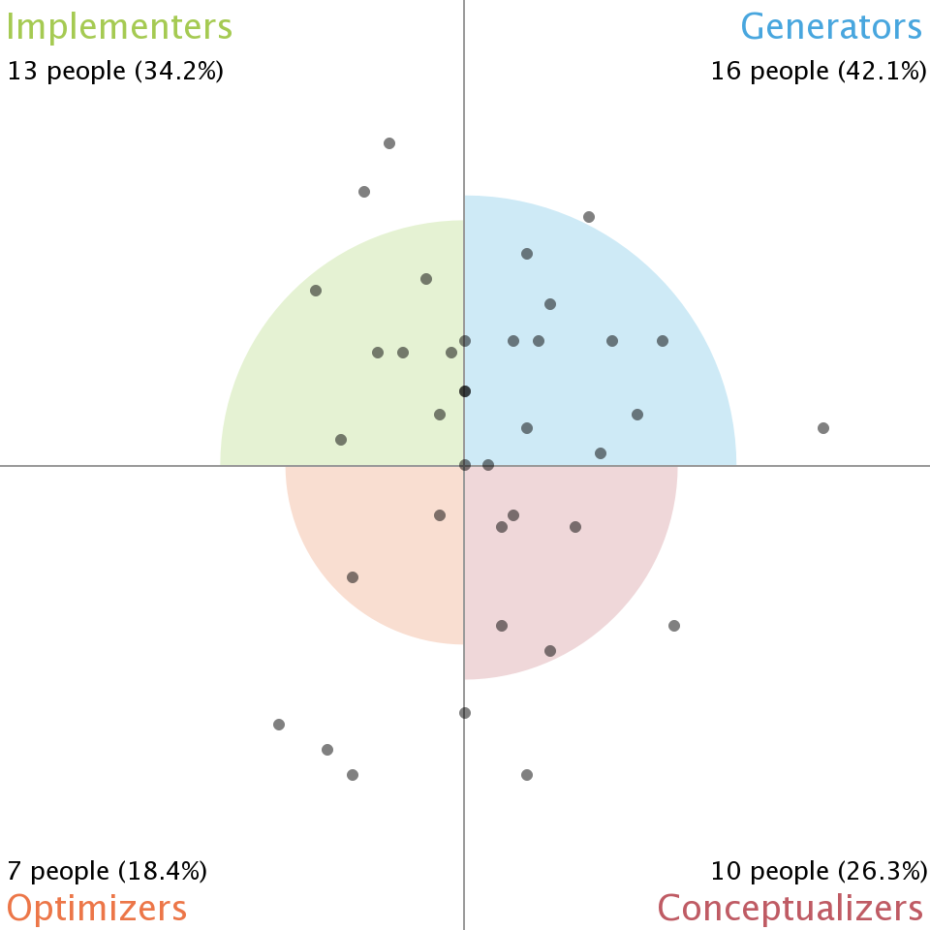
What does our team look like today?
Nou Economic Immigration
Sept 12th, 2017
Total Participants: 38

Slide 42
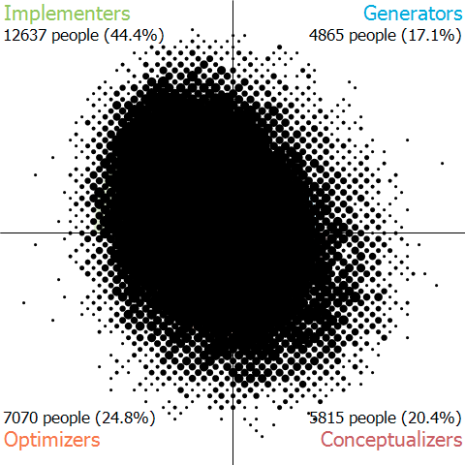
“Professionals” Global Population Distribution * Problem Solving Style Scatter Diagram – Basadur CPSP (n= 30,240)
(n= 30,240)

Slide 43
Some Objectives of the CPSP
Be confident in your own creative style
Help others appreciate and value others’ styles
Diagnose team problems
Set up successful teams
Help others understand creative problem solving as a process

Slide 44
What Is Cognitive Diversity?
It is: Diversity in How people think and problem solve
It is not: Diversity in What people know (due to differences in function, education, race, ethnicity, gender, etc.)

