Slide 1
New Brunswick’s tightening labour market: The largest obstacle to future economic growth?
November 2016

Slide 2
New Brunswick’s economy is too small
NB GDP per capita is 25% below the national average
NB government generates 30 cents in revenue per $1.00 of GDP
If NB GDP per capita was the same as Canada, the economy would generate $2.6 billion more GNB revenue.

Slide 3
The link between workforce growth/decline and GDP growth
Average annual post-recession real GDP growth rates
Average annual labour market growth
Post-Recession Period
Source: Statistics Canada CANSIM Table 379-0030 and 0003.

Slide 4
Labour market participation rate: 25-54 years (%)
Source: Statistics Canada CANSIM Table 051-0001.

Slide 5
‘At risk’ export-based industries
Agriculture, natural resources, and export-based services.
$20.00/hour and under.
‘Mobile’ - meaning jobs that are here now but that could be done elsewhere in Canada or around the world.
Approx. 40,000 to 50,000 NBers currently working in jobs that fit this profile.
Every 1,000 jobs lost (or not gained) directly in these sectors translates into a loss of over $50M worth of income.

Slide 6
Will young NBers work jobs paying less than $35,000/year?
Percentage change between 2008 and 2014 in the number of persons aged 35 and under reporting income of less than $35,000 per year and $50,000+
 | Persons reporting income of under $35,000 | Persons reporting income of $50,000 and over
New Brunswick | -16% | +40%
Moncton | -11% | +41%
Saint John | -17% | +29%
Fredericton | -8% | +46%
Bathurst | -18% | +27%
Miramichi | -7% | +75%
Campbellton | -17% | +40%
Edmundston | -22% | +38%
Non CMA-CA | -21% | +42%
Canada | -4% | +40%
Source: Statistics Canada.

Slide 7
Employment insurance in New Brunswick: A labour market distortion
 | EI income claimants | @ CDN usage rate | Excess EI usage in NB
New Brunswick | 98,500 | 50,406 | +95%
Moncton | 12,480 | 9,976 | +25%
Saint John | 10,510 | 8,327 | +26%
Fredericton | 7,000 | 6,506 | +8%
Bathurst | 5,090 | 2,156 | +136%
Miramichi | 4,250 | 1,798 | +136%
Campbellton | 2,250 | 879 | +156%
Edmundston | 3,020 | 1,501 | +101%
Non CMA-CA NB | 53,910 | 19,265 | +180%
*2014 figures. Source: Statistics Canada.

Slide 8
Immigration and economic renewal
Many of our key, export-oriented industries are starting to struggle finding workers (other industries too).
The unemployment rate is still too high but there are many reasons why this isn’t solving the workforce gap (seasonality, mobility, skills alignment, etc.)
Immigration will be key to addressing our workforce needs.
Immigration will also be an important source of entrepreneurs, ideas and investment.
Immigration will also drive up demand for services and boost local economies around the province.

Slide 9
Immigration and economic renewal
Less than 5% of all workers in NB’s business support services sector are first generation immigrants.
In Vancouver it is 47%. In Toronto it is over 50%.
3% of all workers in manufacturing occupations across NB are immigrants.
In Toronto it is 76%. Across Canada it is 31%.
Will New Brunswickers embrace immigration?
There hasn’t been much immigration into NB since the mid-19th Century.
98% of everyone living in northeastern New Brunswick is at least a third generation Canadian.
It’s 92% across the province, 44% in Montreal, 22% in Toronto.

Slide 10
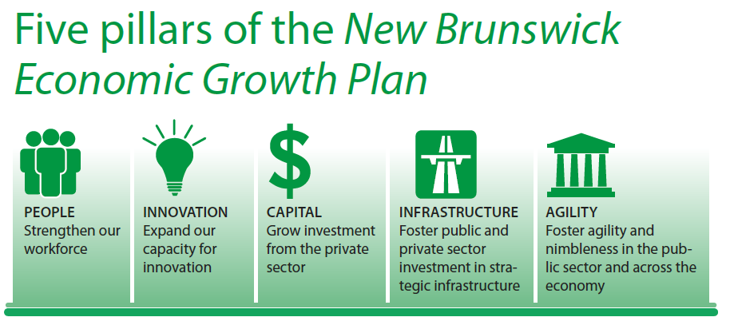

Slide 11
The NB Growth Plan: Boosting the workforce
Ensuring the education system is aligned with current and future demand.
Providing more pathways to the labour market for New Brunswickers.
Big boost in experiential learning.
Targeting programming to support older workers.
Encouraging more
Boosting the number of newcomers attracted to the province.
Atlantic Immigration Pilot – alignment of workers to demand.
Expanding post-secondary enrolment.

Slide 12
The role of the business community
Embrace immigrant workers.
Engage more young New Brunswickers through experiential learning.
Provide better information on current and future workforce needs.
Where possible, support workforce flexibility.
Work towards industry competitive wages – taking into account cost of living.

